Slide 1
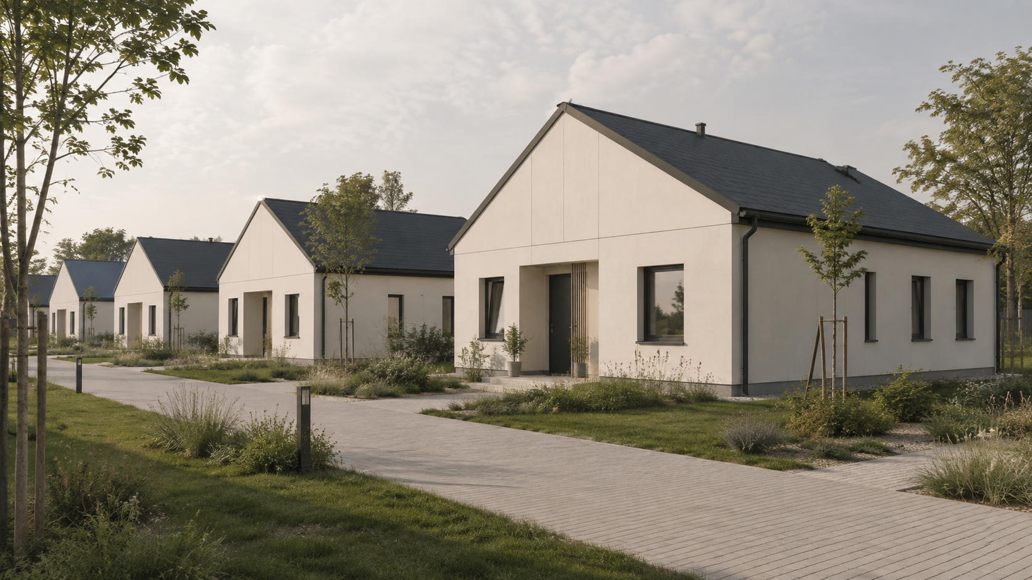
IDOPS BG
Industrial Cooperation Proposal for the Republic of Serbia
Prefabricated SIP Buildings – A Regional Production & Delivery Platform from Bulgaria
Factory-produced · rapidly delivered · locally installed

Slide 2
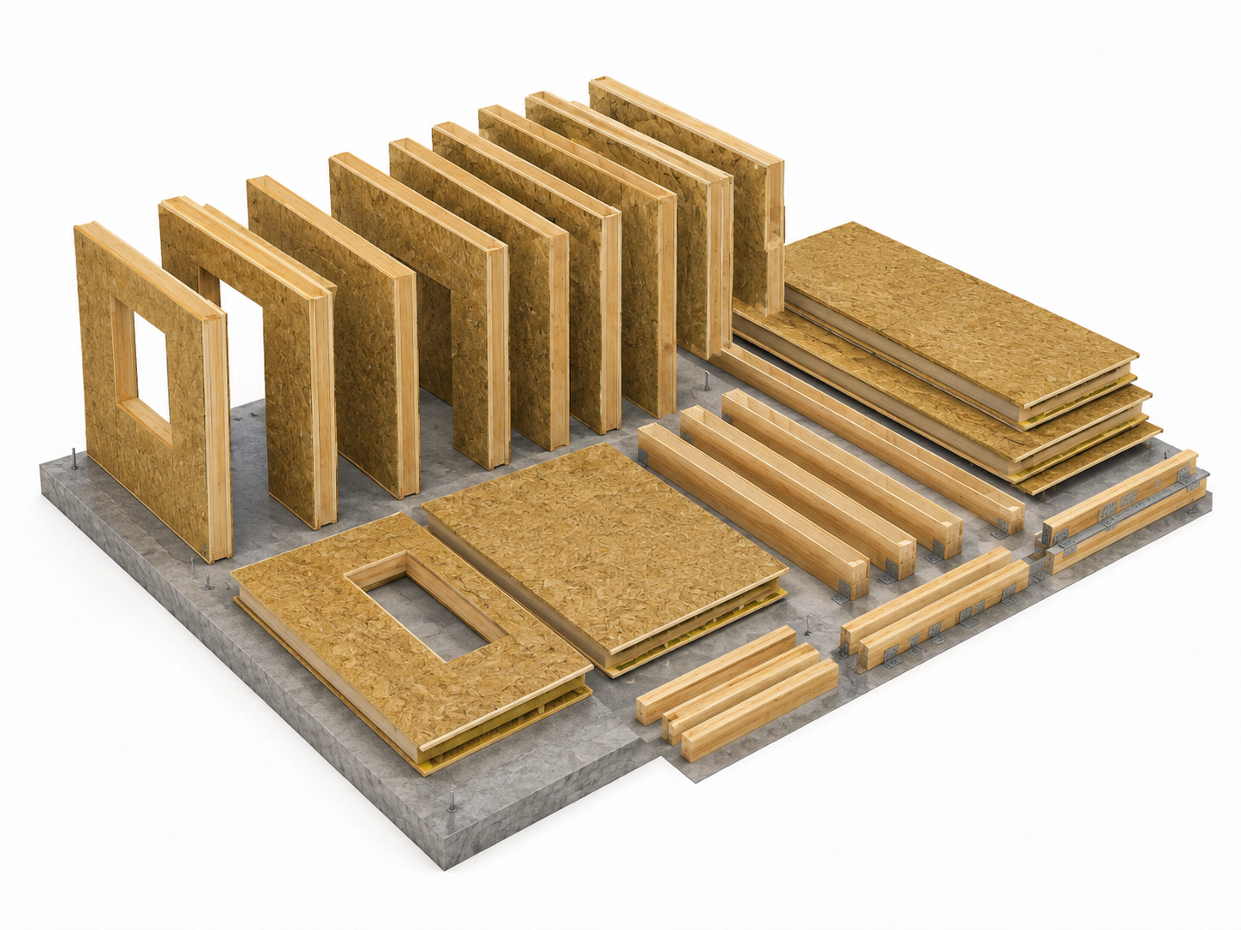
IDOPS BG
EN
02
A faster and scalable way to deliver public buildings
IDOPS BG proposes cooperation based on an existing Bulgarian production facility for SIP systems.
• Complete building elements and finished solutions for projects in Serbia
• Regional production base in neighbouring Bulgaria
• Suitable for housing, education, healthcare, municipalities and rapid-build facilities
Housing
Kindergartens
Health centres
Municipalities
Industrial Cooperation Proposal for Serbia

Slide 3
IDOPS BG
EN
03
Why Serbia - why now?
The goal is not to create demand, but to industrialise its delivery.
2,960
82%
85.4%
permitted dwellings in 06/2025
permits related to buildings
dwellings in buildings with 3+ units
• Serbia has a long-term need for new residential and public infrastructure
• In June 2025, 2,960 new dwellings were permitted
• 82% of permits related to buildings; 85.4% of dwellings were in buildings with 3+ units
• Housing and preschool programmes form a strong entry point for the public sector
Industrial Cooperation Proposal for Serbia
Source: Statistical Office of the Republic of Serbia, building permits, June 2025

Slide 4
IDOPS BG
EN
04
From construction project to production-and-delivery model
Most of the building is created under controlled factory conditions.
1
2
3
4
5
6
7
Design
Production
Pre-assembly
Quality control
Transport
Installation in Serbia
Handover
Repeatable system · adaptable to municipalities · scalable by programme
Industrial Cooperation Proposal for Serbia

Slide 5
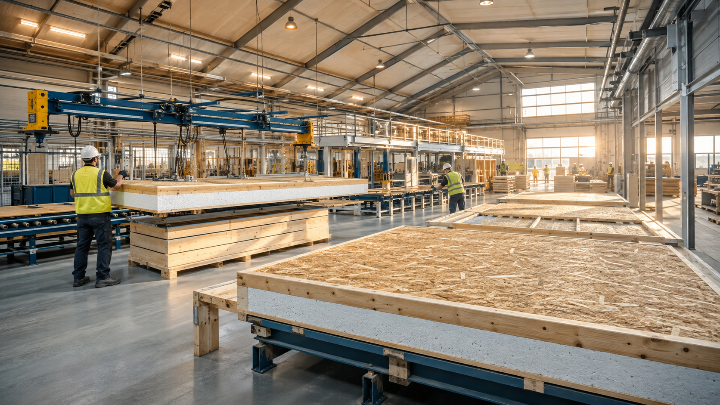
IDOPS BG
EN
05
The Bulgarian factory as the regional production base
Serbia gains industrial construction capacity without waiting for a new factory to be built.
Production in Bulgaria
• Structural SIP panels
• Wall / roof / floor elements
• Pre-assembled modules
• Openings and building envelope
• MEP preparation
• Finishing packages
• Complete building kits
Delivery to Serbia and local completion
Regional logistics · Site preparation · Rapid installation · Local connections · Commissioning
Bulgarian industrial production + Serbian delivery capacity
Industrial Cooperation Proposal for Serbia

Slide 6

IDOPS BG
EN
06
What is a SIP building?
Structural insulated panels combine load-bearing structure and insulation in a precise system.
Structural skins
Insulation core
Factory production
Precision cutting
Rapid assembly
Speed
Energy efficiency
Quality
Repeatability
Low waste
Industrial Cooperation Proposal for Serbia

Slide 7
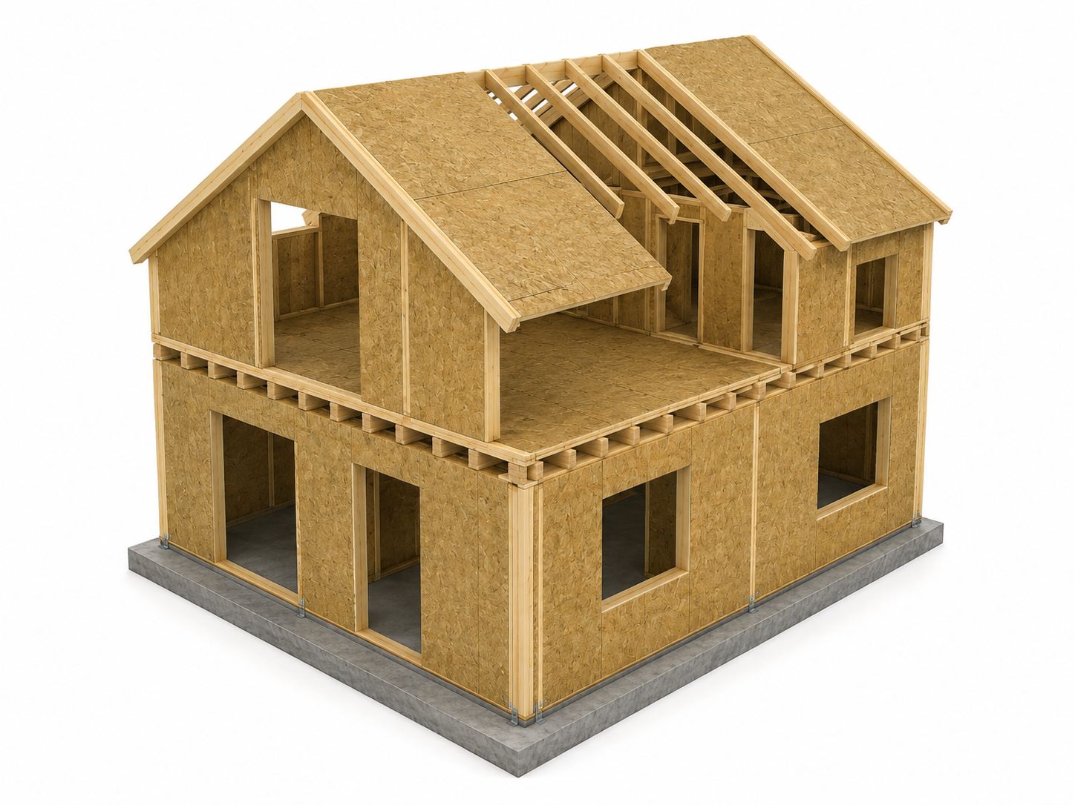
IDOPS BG
EN
07
From panels to complete buildings
ZIPHOME as a complete prefabricated building solution - not only a panel supplier.
Complete prefabricated building solution on an industrial SIP platform
Structure
Envelope
SIP walls, floors and roof
Insulation, membranes, facade systems
Openings
MEP preparation
Windows and doors
Electrical, water, drainage and HVAC interfaces
Interior
Equipment
Walls, ceilings, floors and finishes
Sanitary equipment, kitchens and project-specific elements
Site installation
Assembly with Serbian contractors
Industrial Cooperation Proposal for Serbia

Slide 8
IDOPS BG
EN
08
Product family for Serbia
One industrial platform can serve multiple public applications.
Social housing
Kindergartens
Health centres
Municipal buildings
Emergency facilities
Homes of 50-120 m², duplexes, row houses, small apartment buildings
Classroom, sanitary, kitchen and administration modules
Primary care, rural points, outpatient clinics and vaccination
Offices, social services, community and support facilities
Rapid accommodation and public infrastructure
Relevant because Serbia has already used prefabricated houses in housing-support programmes.
Industrial Cooperation Proposal for Serbia

Slide 9
IDOPS BG
EN
09
Social housing - flagship application
A standardised housing programme for Serbian municipalities.
50-60 m²
60-80 m²
80-100 m²
100-120 m²
compact unit
smaller family
family house
larger family
• The state or municipality selects the required typology
• The factory produces a repeatable building system
• Variants: family houses, duplexes, row houses, small apartment buildings
Standard design catalogue → repeatable municipal delivery
Industrial Cooperation Proposal for Serbia
Sources: RHP Serbia / WBIF / Ministry of Education ECEC project

Slide 10
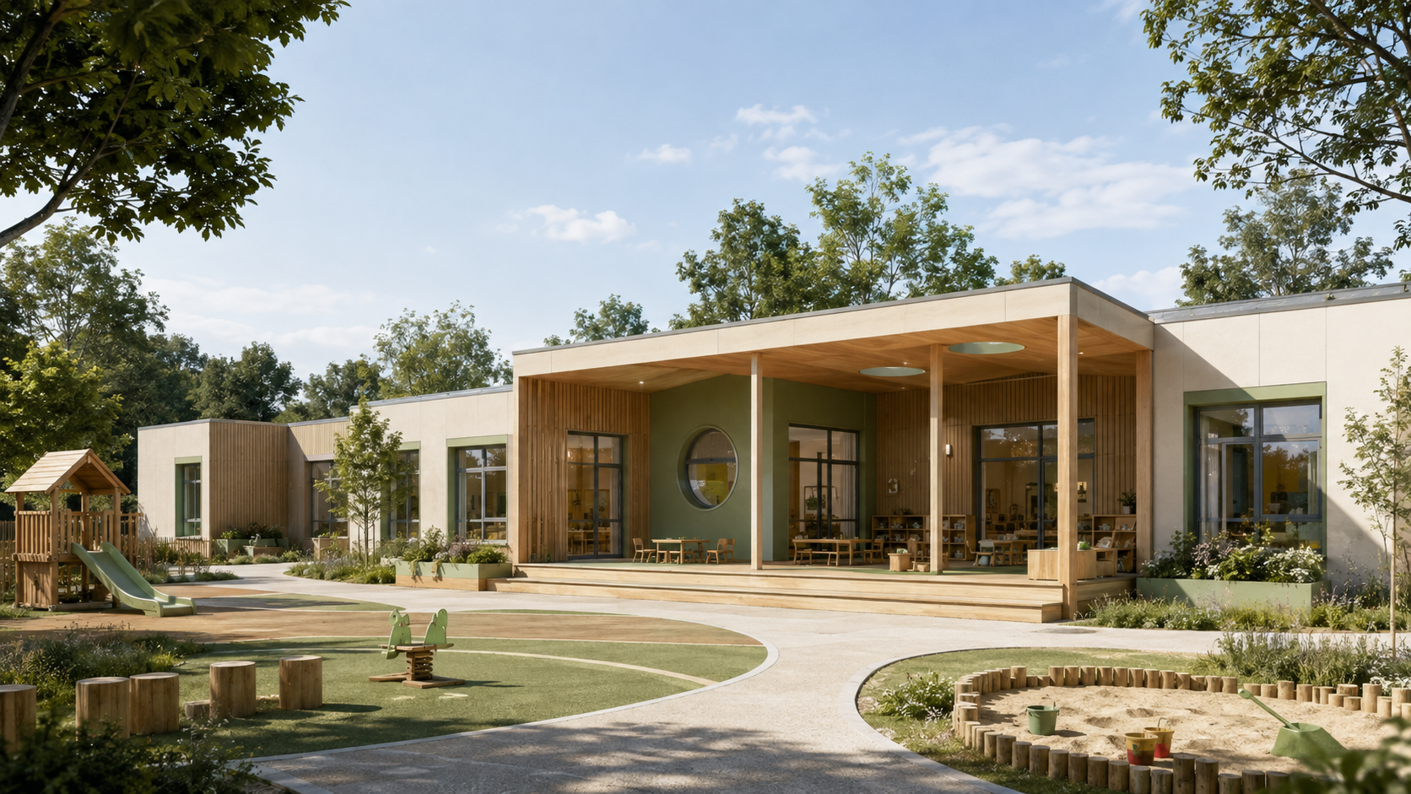
IDOPS BG
EN
10
Kindergarten concept
A standard kindergarten adaptable to municipal capacity and requirements.
Classrooms
Sleeping rooms
Sanitary blocks
Kitchen / food preparation
Administration
Technical rooms
Covered outdoor areas
One proven reference building can become a template for 10, 20 or 50 locations.
Industrial Cooperation Proposal for Serbia

Slide 11
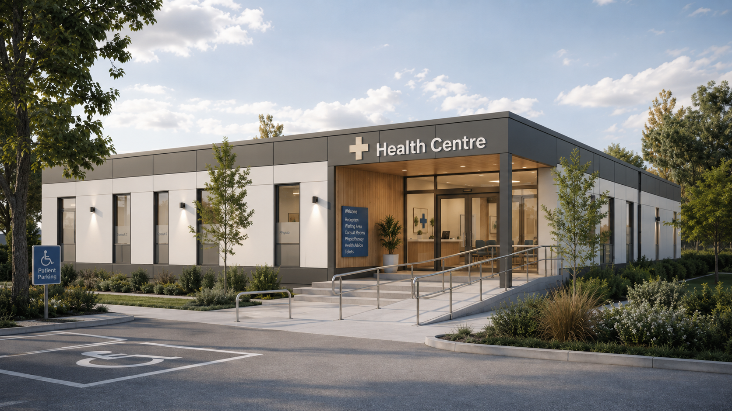
IDOPS BG
EN
11
Health-centre concept
Small modular healthcare facilities for local communities.
Primary care
Rural health points
Outpatient clinics
Family medicine
Dental facilities
Diagnostics
Vaccination rooms
Community health
One proven reference building can become a template for 10, 20 or 50 locations.
Industrial Cooperation Proposal for Serbia

Slide 12
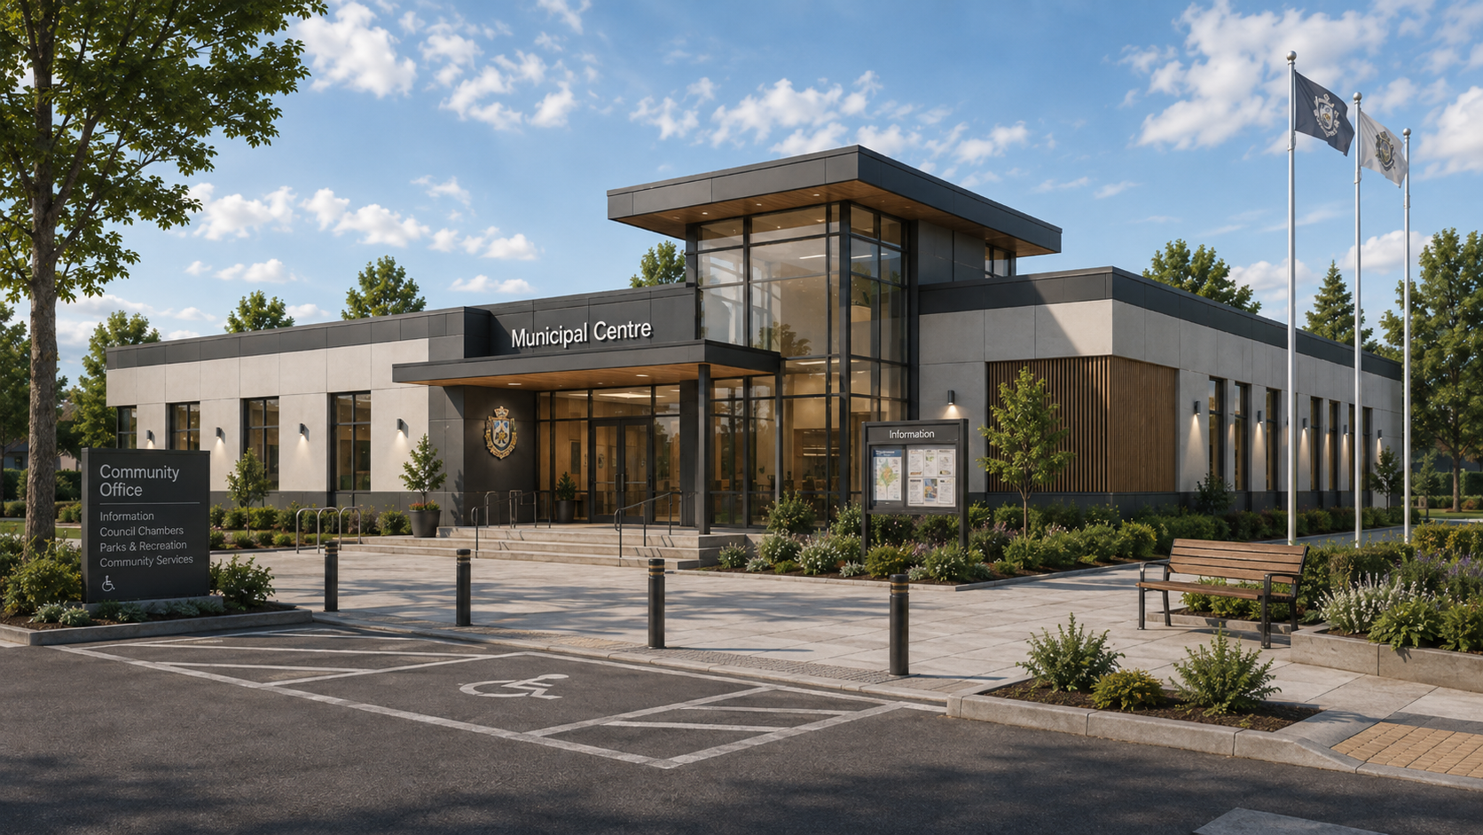
IDOPS BG
EN
12
Municipal buildings
The same production platform - multiple public uses.
Municipal offices
Local administration
Community centres
Social services
Cultural buildings
Police / fire support
Technical buildings
Service buildings
One proven reference building can become a template for 10, 20 or 50 locations.
Industrial Cooperation Proposal for Serbia

Slide 13
IDOPS BG
EN
13
Proposed Serbia-Bulgaria cooperation model
A clear division of roles from public programme to delivered building.
Republic of Serbia
Public programmes · municipalities · project pipeline · land / infrastructure · permits · procurement
IDOPS BG
Project development · standardisation · engineering · production coordination · quality management
Bulgarian factory
SIP production · pre-assembly · components · quality control · packaging · logistics
Serbian delivery partners
Site preparation · foundations · installation · MEP connections · local works · handover
Serbian public building
Housing · kindergarten · health centre · municipal facility
Industrial Cooperation Proposal for Serbia

Slide 14
IDOPS BG
EN
14
Why manufacture in Bulgaria?
A practical regional route to rapid concept validation and subsequent scale-up.
Proximity
Existing base
Neighbouring countries enable short logistics routes.
There is no need to wait for a new Serbian factory.
EU environment
Scalability
Access to European supply chains and standards.
Output can grow according to the Serbian pipeline.
Repeatability
Standard buildings can be produced in batches.
A nearby production base for Serbian public infrastructure
Industrial Cooperation Proposal for Serbia

Slide 15
IDOPS BG
EN
15
Why this model benefits Serbia
A government-oriented model focused on speed, quality and local delivery.
01
Faster delivery
02
Predictable quality
03
Lower site complexity
04
Reduced waste
Production can proceed simultaneously with site preparation.
Controlled environment and repeatable details.
More work is completed before arrival on site.
Cutting and production are carried out under control.
05
Standardisation
06
Regional source
07
Scalability
08
Local employment
One approved solution becomes a product.
A neighbouring factory provides nearby capacity.
From one building to a national framework.
Serbian companies remain key to delivery.
Industrial production does not replace Serbian capacity - it strengthens project delivery.
Industrial Cooperation Proposal for Serbia

Slide 16
IDOPS BG
EN
16
From one project to a national programme
Cooperation can develop from a demonstration to a long-term framework programme.
Pilot
Municipality
Region
National framework
10-20 houses / one facility
50-100 buildings
Several municipalities
Annual production allocation
IDOPS BG proposes a scalable regional supply platform for Serbian public infrastructure.
Industrial Cooperation Proposal for Serbia

Slide 17
IDOPS BG
EN
17
Pilot programme proposal
The Serbia-Bulgaria pilot should verify the buildings, delivery process and local cooperation.
Phase 1 - Demonstration
Phase 2 - Evaluation
Phase 3 - Scale-up
• 5-10 residential units
• 1 kindergarten
• 1 small health centre
• 1 municipal / community building
• Construction time
• Total project cost
• Energy performance
• Waste and installation time
• Local labour requirements
• User satisfaction
• Standardised designs
• Framework procurement
• Municipal rollout
• Repeatable project pipeline
Industrial Cooperation Proposal for Serbia

Slide 18
IDOPS BG
EN
18
Serbian local participation
Politically and economically, the proposal should not appear as a pure import model.
Serbian local delivery
Foundations
Earthworks
Transport
Cranes
Montáž
Electrical works
Plumbing
HVAC
External works
Landscaping
Maintenance
Facility management
Industrial Cooperation Proposal for Serbia

Slide 19
IDOPS BG
EN
19
Sustainability
Practical resource efficiency and long-term building performance.
Industrialised construction
Energy-efficient envelope
Long-term use
Controlled material use
Lower heating / cooling demand
Durable building envelope
Less site waste
Higher comfort
Easy maintenance
Efficient logistics
Consistent quality
Adaptable layouts
Precision manufacturing
Industrial Cooperation Proposal for Serbia

Slide 20
IDOPS BG
EN
20
Requested government cooperation
A clear agenda for the first stage of cooperation.
1
Identify priority public-building programmes
2
Select pilot municipalities
3
Define standard building typologies
4
Set technical and regulatory requirements
5
Evaluate the Bulgarian production platform
6
Develop pilot projects
7
Create a framework for repeat projects
8
Explore long-term Serbia-Bulgaria industrial cooperation
Goal: move from discussion to selected pilot concepts and a repeatable delivery framework.
Industrial Cooperation Proposal for Serbia

Slide 21
IDOPS BG
EN
21
Proposed next step
Joint Serbia-IDOPS BG working group.
IDOPS BG
Serbian side
Jointly
• Present factory capacity
• Provide SIP technology documentation
• Provide sample designs
• Propose a building catalogue
• Calculate indicative capacity
• Prepare pilot concepts
• Identify priority programmes
• Identify municipalities
• Define technical requirements
• Identify pilot locations
• Clarify the procurement and regulatory pathway
• Select pilot
• Approve concept
• Produce prototype
• Build
• Evaluate
• Scale
select
approve
produce
build
evaluate
scale
Industrial Cooperation Proposal for Serbia

Slide 22
IDOPS BG
From a Bulgarian production base to a regional platform for Serbian public infrastructure.
Factory-produced.
Rapidly delivered.
Locally installed.
Scalable for Serbia.
Housing | Social Housing | Kindergartens | Health Centres | Municipal Buildings

Slide 23
IDOPS BG
EN
23
Contact
For further discussions on the pilot programme and regional cooperation.
COMPANY
IDOPS BG OOD, ID: 175310590
E-MAIL
info@ziphome.eu
PHONE
+421 917 999 119
Factory-made · fast delivery · local assembly
Scalable for Serbia
ADDRESS
Industrial Cooperation Proposal for Serbia
53-55 Bulvar Totleben, Sofia, Bulgaria

